Slide 1
Hangman : Nations
Final Presentation
By Ajil Pappachan, L4 GDV

Slide 2
Ideas Pitched

Slide 3
Millionaire
Based on the TV show 'Who wants to be a millionaire’
Objective is to get as many points as possible by answering multiple choice questions
Questions are generated randomly using a function to print an element from an array of text elements

Slide 4
2. Hangman
Based on the Sketch and Paper Game of the same name
Objective is to guess the name of a country, one letter at a time
If the Player guesses a letter wrong 5 times, he loses the game
A random country name is generated from an array of names

Slide 5
3. Fresher's Day
Story driven game
Game takes place during the first day of class at a new college
Objective is to gain the trust and appreciation of fellow classmates and teachers
Classmates and Teachers form an opinion of the Player based on the Player’s interactions with them and the performance in class tests

Slide 6
Critical Analysis

Slide 7
An interview was conducted with selected individuals to finalize one game idea.

Slide 8
Based on the interview results, it was concluded to finalize Hangman.

Slide 9
About Hangman
Hangman is a text based game based on the Pencil and Paper game of the same name. The objective of the game is to guess the name of a country, one letter at a time. However, if the player makes 5 wrong guesses, he/she loses the match.

Slide 10
Prototype and Updates

Slide 11
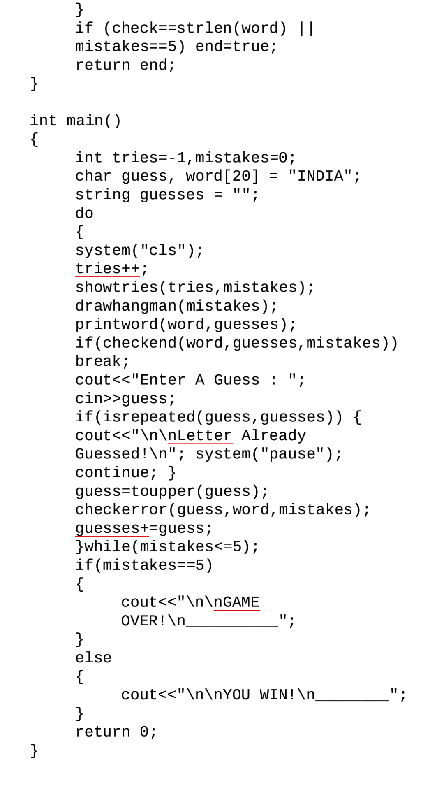
First Prototype
A working prototype was created with the basic functionalities of the game. The prototype was showcased and updates were planned based on the reviews.

Slide 12
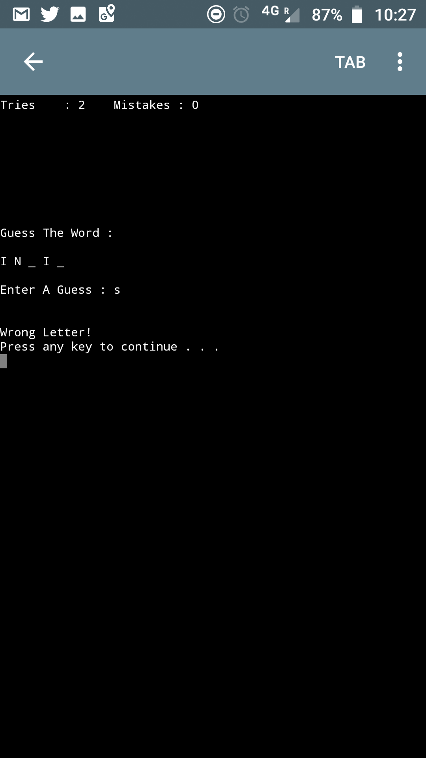
Prototype Output Screen

Slide 13
Several updates were made to the original prototype to test new features and fix bugs

Slide 14
Hangman V2.0
*Added Comments in the Code
*Added Main Menu Feature
*Included Game Rules in the Program
*Changed the Background and Font Colors

Slide 15
Hangman V3.0
*Added Background Music
Hangman V3.0 Source file was corrupted therefore a new update was necessary

Slide 16
Hangman Nations V4.0
*Added more country names
*Fixed Isrepeated() Function
*Changed Game Name to Hangman : Nations
*Fixed Empty Space in Country Name Glitch

Slide 17
Hangman Nations V5.0
*Fixed the “Invalid Option” Main Menu Glitch
*Improved Visuals

Slide 18
Hangman : Nations V5.0 was the final version of the game.

Slide 19

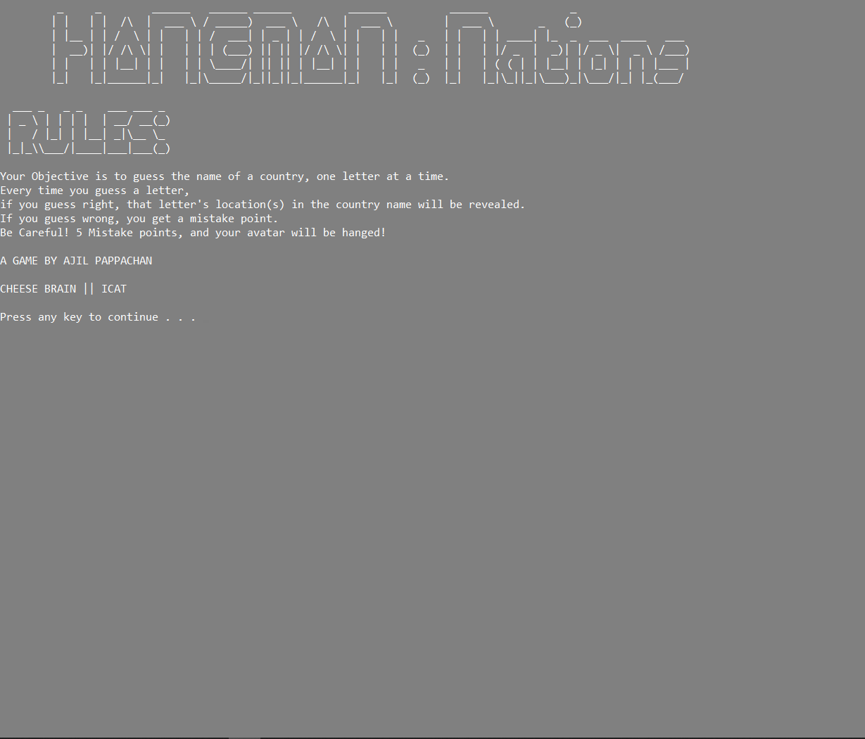
Final Output Screen

Slide 20
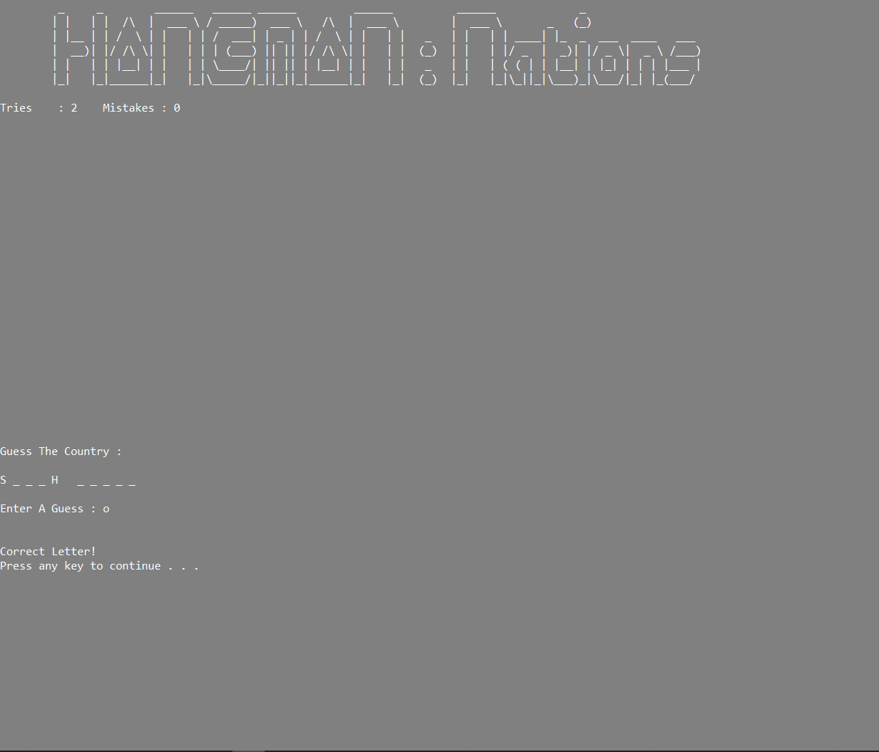
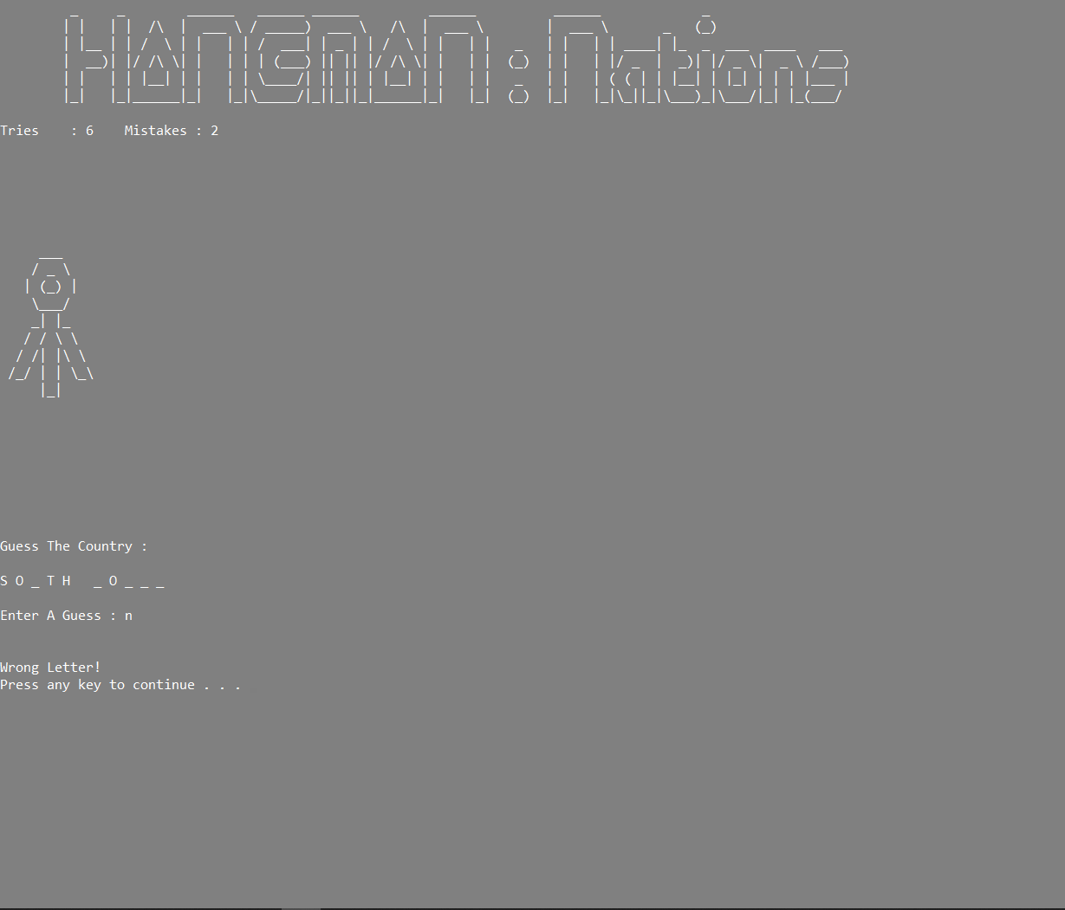
Final Output Screen

Slide 21
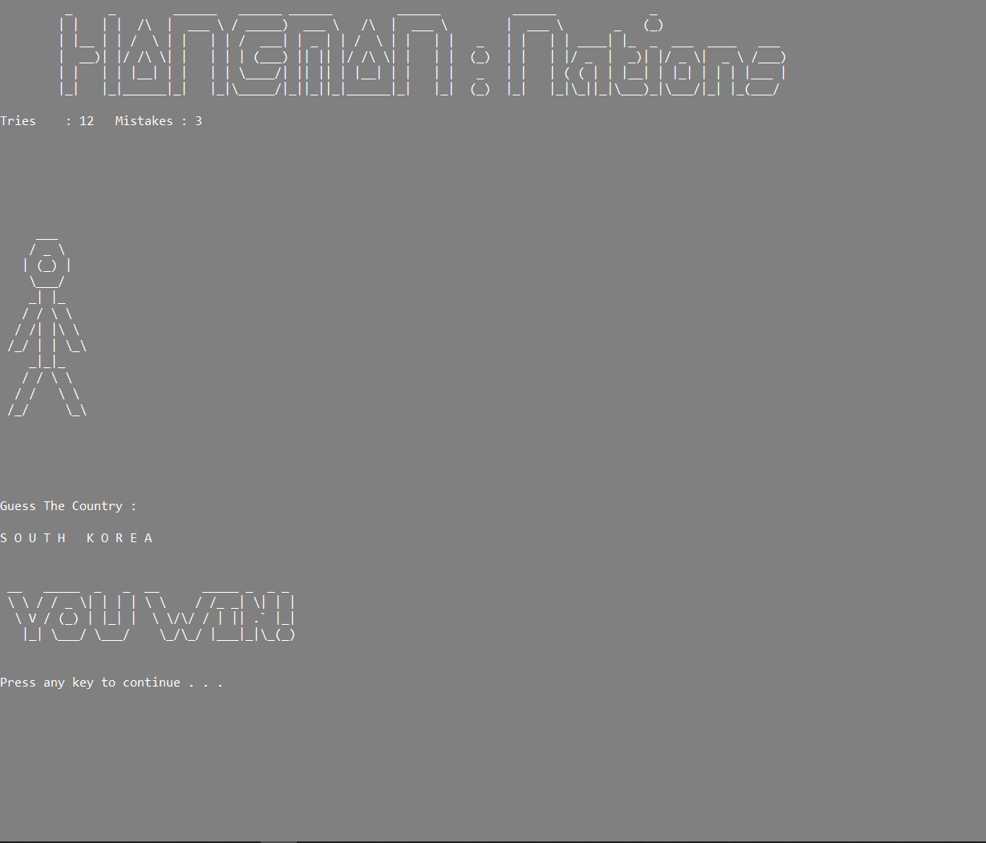
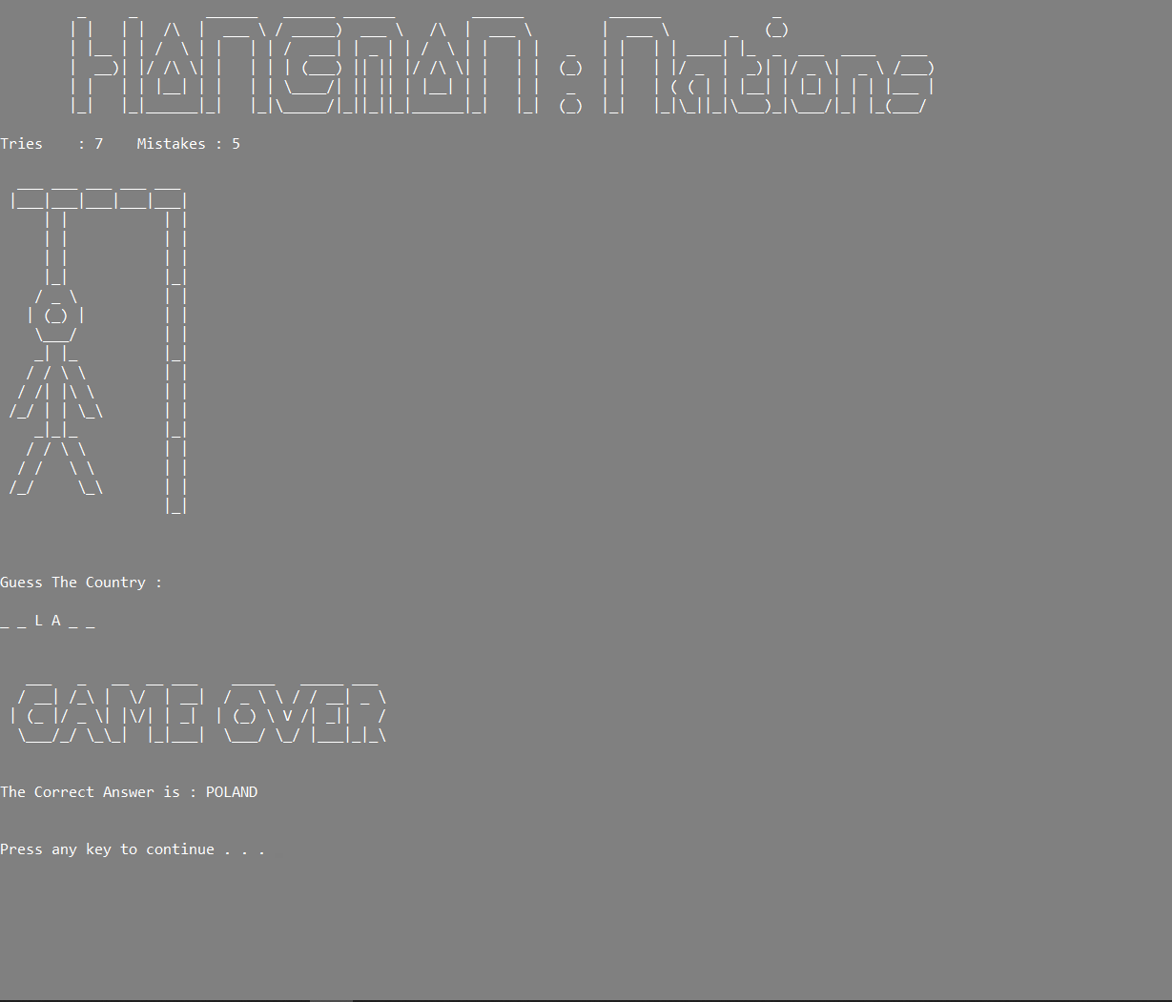
Final Output Screen

Slide 22
The End
Thank You!

